Slide 1
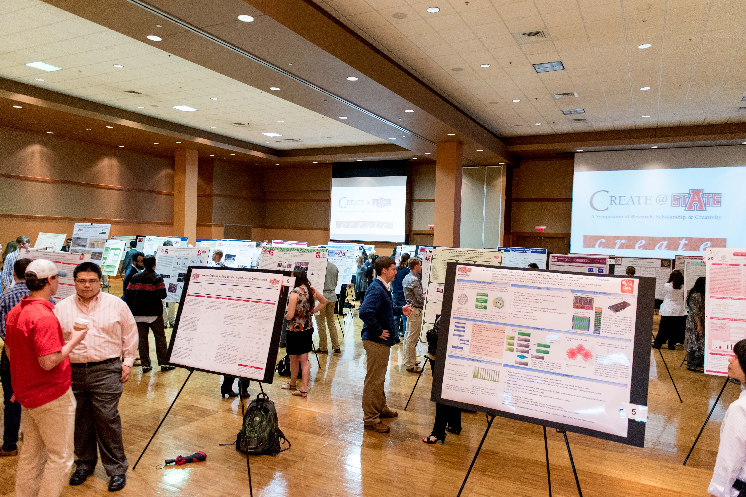
Pilot of a Co-Curricular Assessment Model at Arkansas State University for Student Research Events
*Assessment Mini-Grant Recipient, 2017-2018
Emily Devereux, MPA, CRA
Executive Director of Research Development
Advisor, A-State Student Research Council
AState.edu
/AStateResearch
@AStateResearch
Learn @ State, March 14, 2018, Arkansas State University A Celebration of Investigations into Student-Learning Assessment
A-State Student Research Council

Slide 2
Student Research Event Assessment Tool
Official Symposium of University
Student Showcase
Inclusive of all 6 Colleges
Collaboration between RTT, Advancement, Learning Commons, SRC Committees for event and assessment activities
AState.edu
/AStateResearch
@ArkansasState
Learn @ State, March 14, 2018, Arkansas State University A Celebration of Investigations into Student-Learning Assessment
A-State Student Research Council

Slide 3
Student Research Event Assessment Tool
Reason for Co-Curricular Assessment:
Provide evaluative methods to assess how participation in co-curricular student activities such as Create@State provides a learning platform for identified SLOs:
Communication Skills
Creative & Critical Thinking
Learning outcomes believed to be gained DURING:
Abstract composition process
Presenting/Dissemination of work to diverse audience
AState.edu
/AStateResearch
@ArkansasState
Learn @ State, March 14, 2018, Arkansas State University A Celebration of Investigations into Student-Learning Assessment
A-State Student Research Council

Slide 4
Student Research Event Assessment Tool
Methods:
Qualitative & Quantitative
Survey adaptation of the Undergraduate Research Student Self-Assessment (URSSA; Hunter et al. 2009) instrument (to address research, scholarly & creative works)
Rubrics – Abstract & Presentation
AState.edu
/AStateResearch
@ArkansasState
Learn @ State, March 14, 2018, Arkansas State University A Celebration of Investigations into Student-Learning Assessment
A-State Student Research Council

Slide 5
Student Research Event Assessment Tool
Data Analysis & Action Plan, April –May 2018.
Determine/improve learning process for student research events.
Metrics/benchmarks for competitive federal proposals (institutional support of student research & broader impacts).
Stewardship for Advancement.
Piloted model for assessment of student research events to be further refined and repeated at additional institutions
AState.edu
/AStateResearch
@ArkansasState
Learn @ State, March 14, 2018, Arkansas State University A Celebration of Investigations into Student-Learning Assessment
A-State Student Research Council

